Slide 1
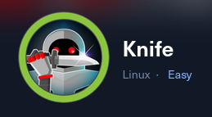
HTB machines - Knife
Write up by Chanan shenker

Slide 2
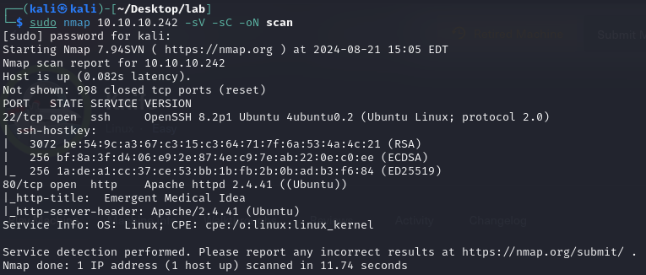


Start: Enumeration
I started with a basic Nmap scan and uncovered two port running on the target machine.
Port 22 that is ssh and port 80 that has a web application running on it.
For further investigation I go look at the web application running on the target.
In the actual web page it looks quite broken and has not much to see or click on. I tried using gobusetr to find any directories or sub domains and found nothing.
Next I decided to use “wappalyzer”.

Slide 3


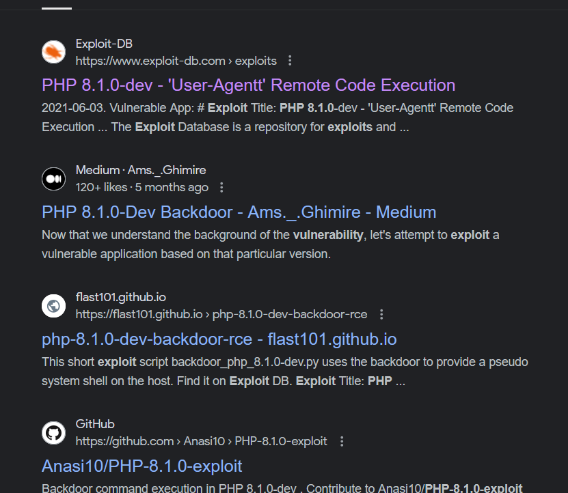
Wappalyzer:
Wappalyzer is a tool that identifies the technologies used on websites, such as web frameworks, CMS, and analytics tools. It's useful for gaining insights into a website's tech stack, helping developers, marketers, and security professionals analyze and understand the underlying architecture.
When looking at the information given by wappalyzer we can see that the programming language on the page is “PHP 8.1.0.”
When searching for “PHP 8.1.0 exploits” I immediately find multiple options presented. A bunch of RCE (remote code execution) scripts, but looking a further a bit I find a github page with a reverse shell exploit for this exact PHP version.
Exploit by flast101:
https://github.com/flast101/php-8.1.0-dev-backdoor-rce/blob/main/revshell_php_8.1.0-dev.py

Slide 4

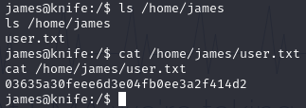
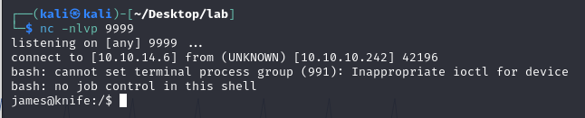
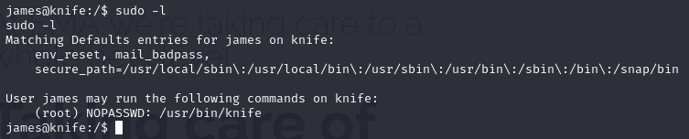
Explotation:
After downloading the script and figuring out the how to use the exploit it was quite easy to obtain a shell with a netcat listener.
And lastley locating the user flag.
Privilege escalation:
To find the root flag I must see how we can get higher privileges.
When running “sudo -l” we can see what command “james” can run as a root user.
As we can see he can run knife as root.

Slide 5



Knife:
Knife is a command-line tool for Chef, a configuration management platform. It manages nodes, cookbooks, and environments, and interacts with the Chef server and your infrastructure. Knife allows you to automate tasks, deploy configurations, and manage servers efficiently, making it a central tool in Chef's ecosystem.
When looking at the knife help menu I found a option to run commands. A little digging led me to figure out it runs ruby commands.
After finding out how to run system command with ruby I can successfully retrieve the root flag.

Slide 6
